Slide 1
The Platinum Packaging Group
Presents:
SV300R™
Heat-Sealing Solution

Slide 2
SV300R™ SEALING SOLUTION
Provides a low cost film sealing (closure) option
Efficient. Seals 8 - 10 trays per minute
Easy-to-use
Versatile: Seals PET Paperboard, CPET, PP, OPS, and HDPE Trays
Compact - requires little counter or table space

Slide 3
SV300R™ Sealing Solution -
New & Improved Features & Benefits!
New! Film staging bar - assures good tight seals
New! Sealing head opens up higher for easy access to film
New! Easy to read thermometer for temperature control and monitoring
New! Film cut-off less than 1/4” from back of tray
New! Heat-seals trays up to a maximum: 10” long x 8” wide x 4-1/2” depth
New! Stronger - 35% more stainless steel and aluminum construction
New! Sealing Bar Assembly Set (optional)
All parts are made in the USA

Slide 4
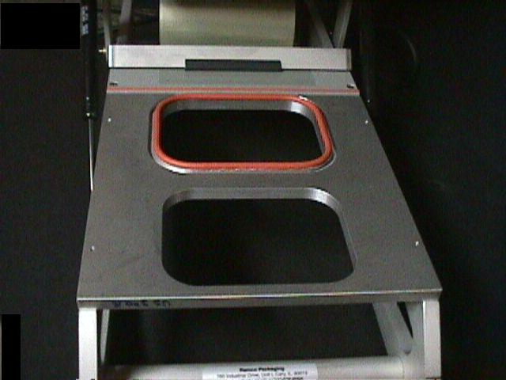
SV300R™ Set up
Select appropriate tray-sealing holder

Slide 5
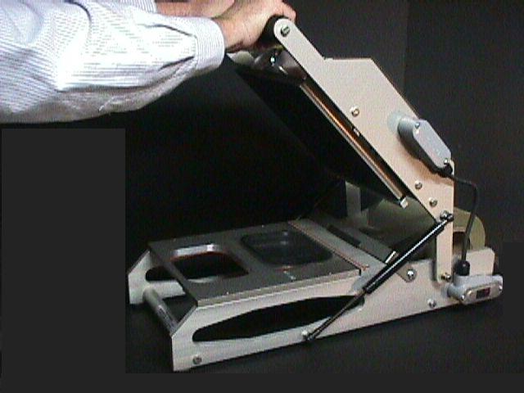
SV300R™ - Film Preparation
Lift the platen-sealing handle

Slide 6
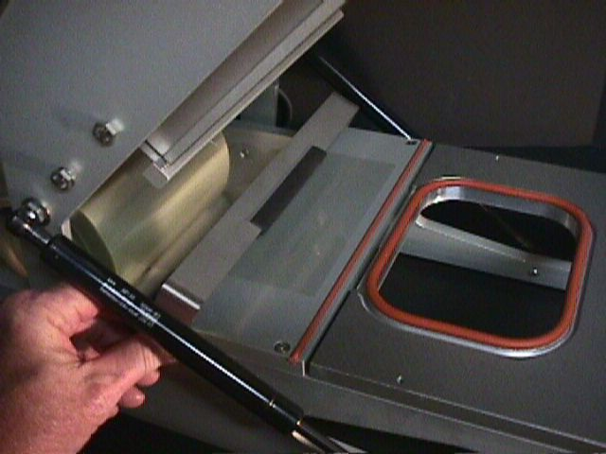
SV300R™ - Film Staging Bar
Lift film staging bar and feed film through to tray-sealing holder

Slide 7
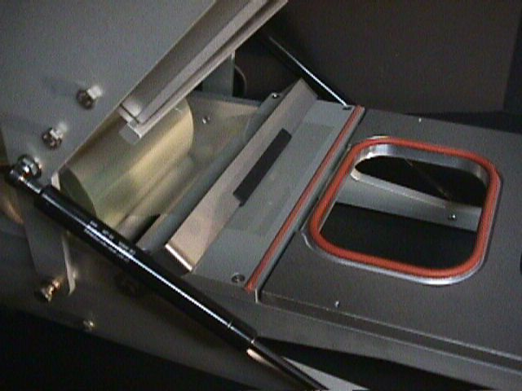
SV300R™ - Film Staging Bar
Pull film underneath film staging bar.
Film staging bar holds film in place until ready to use.

Slide 8
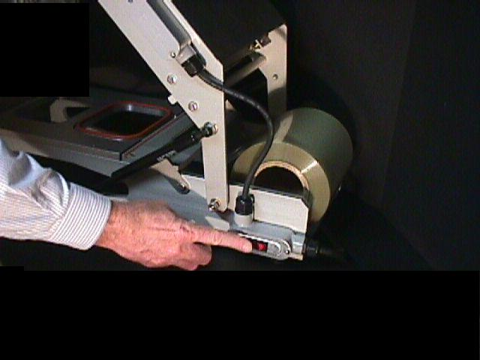
SV300R™ Pre-heat the sealing platen
Press the MAIN power switch to the (RED) ON position.

Slide 9
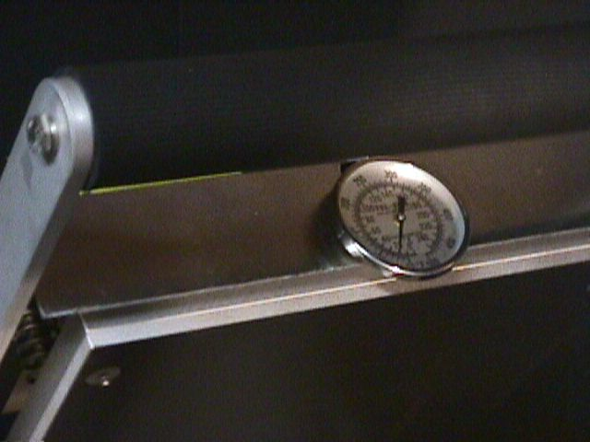
SV300R™ Pre-heat the sealing platen
The sealing platen will come up to operating temperature.
Wait (30) thirty minutes before heat-sealing

Slide 10
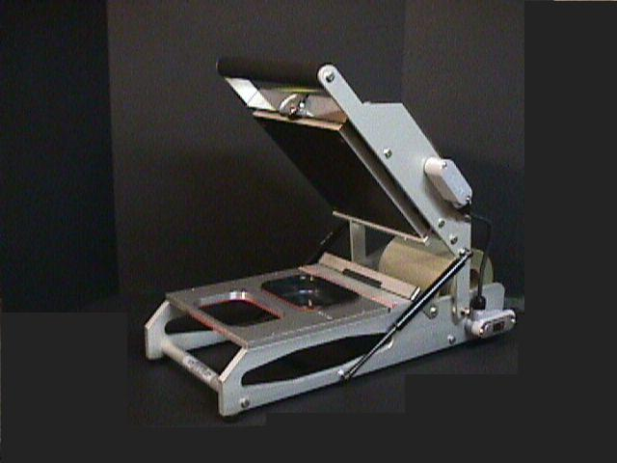
SV300R™ Set up
Ready for Operation

Slide 11
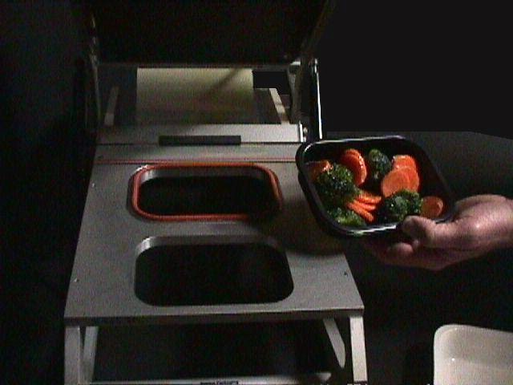
SV300R™
Place filled tray into the tray-sealing holder

Slide 12
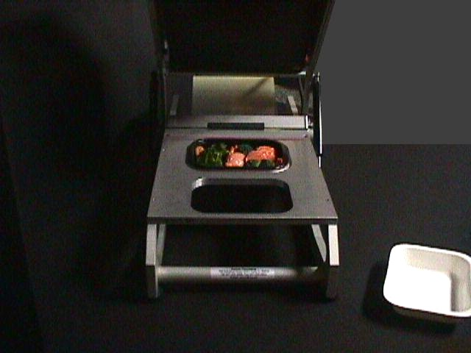
SV300R™
Tray is ready to be film sealed

Slide 13
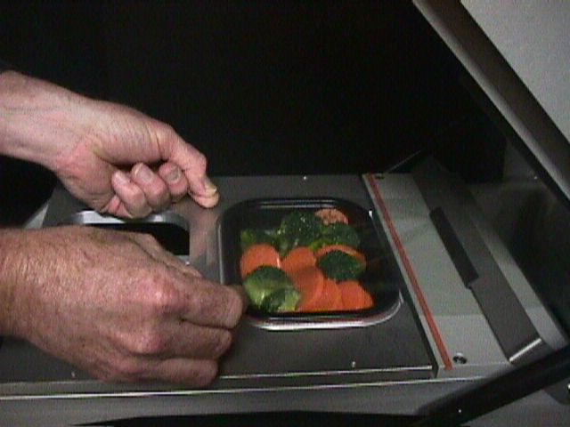
SV300R™
Pull sealing film across the tray to be sealed

Slide 14
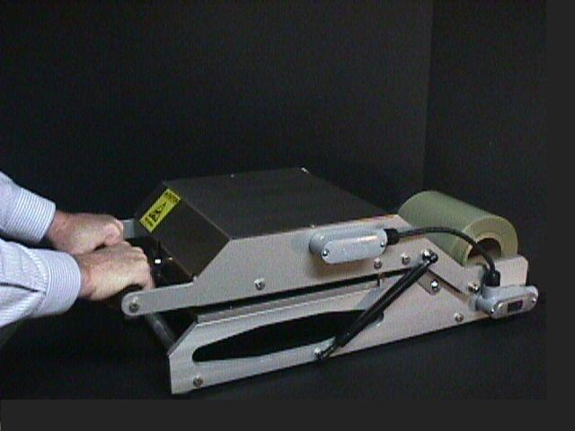
SV300R™
Pull down platen-sealing handle firmly for one to two seconds

Slide 15
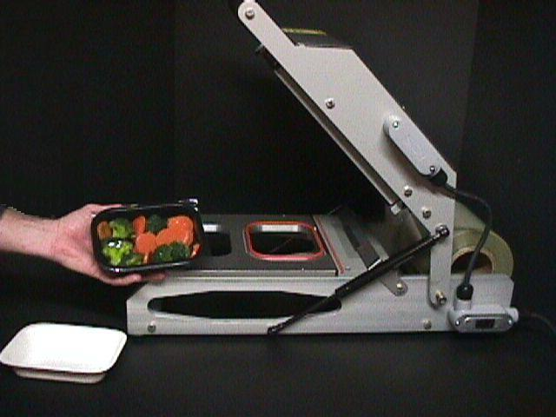
SV300R™
All Done!

Slide 16
SV300R™ Sealing Solution- SPECIFICATIONS:
SV300R™ Length 25.750” Width 14.00” Height (open) 21.500” Height (closed) 9.250” Weight ( with die) *38 lbs. *(includes one tray-holder) Maximum Tray Size 8” x 10” Electrical 120 VAC 60 Cycles 10 AMP FDA APPROVED ETL/C-ETL COMPLIANCE #97001925-001
Lid Film Maximum web width: 9.250” Rolled Film on 3” cores/10” roll diameter
Warranty Ninety days from receipt; parts and labor

Slide 17
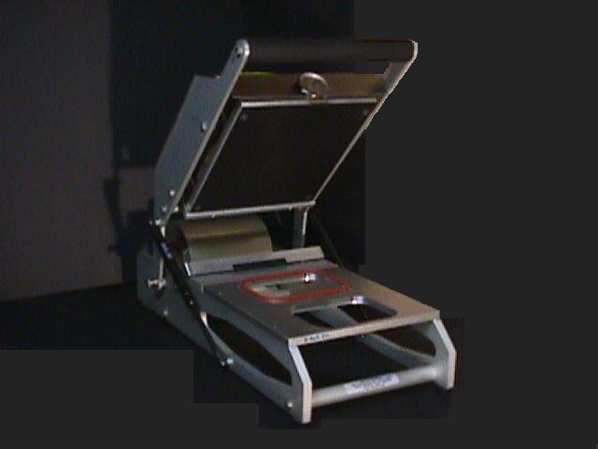
The Platinum Packaging Group
7627 Somerset Blvd.
Paramount, CA 90723
T: (562)630-6700
www.PlatinumPkgGroup.com
Call and Order a SV300R™ Today!

